Slide 1




Laboratory Safety Training
Division of Science and Mathematics
08/03/2012

Slide 2
Introduction
Safety is an obligatory topic to be discussed prior to start working in the laboratory.
The following training will allow students to learn and apply general laboratory safety rules, making the experimental environment at LCCC safer for students, faculty and staff.
This is by no means a complete, terminal discussion of all topics and rules. Instructors will also have a safety discussion in the classroom, as pertinent to each course.

Slide 3
General Safety Rules
Please note: your laboratory instructor will ask you to leave the lab if the safety rules are not followed!
  NO food or drink in the lab.
  Students are not allowed to work in the lab without an instructor present.
  Only students registered in science courses with lab are allowed to be in the laboratory.
  Eye protection must be worn at all times, as indicated.
  Keep your hands away from your face, while working.
  Wash your hands as often as possible, especially before leaving the lab.
  Do not wear protective gear outside the lab, including lab coats, gloves, etc.
  Keep your workstation neat and clean.
  Be well prepared before you come to the lab.
  Know what to do in case of emergency.

Slide 4
Personal Protective Equipment (PPE)…

Slide 5
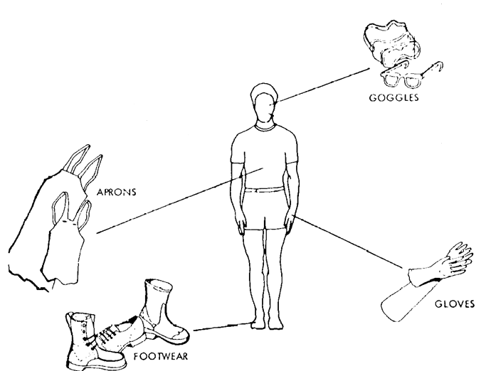
Personal protective equipment (PPE) is special gear used to protect the wearer from specific hazards of a hazardous substance. It is a last resort protection system.
PPE does not reduce or eliminate the hazard, protects only the wearer, and does not protect anyone else.
PPE includes gloves, eye protection, and protective clothing.

Slide 6
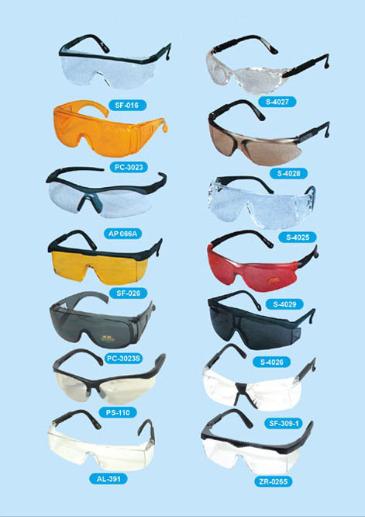
Eye Protection…
Safety glasses do not provide adequate protection from significant chemical splashes. They do not seal to the face, resulting in gaps at the top, bottom and sides, where chemicals may seep through. Safety glasses may be adequate when the potential splash is minimal.
Safety glasses are also not appropriate for dusts and powders, which can get by the glasses in ways similar to those described above. Safety goggles are best used for this type of potential exposure.

Slide 7
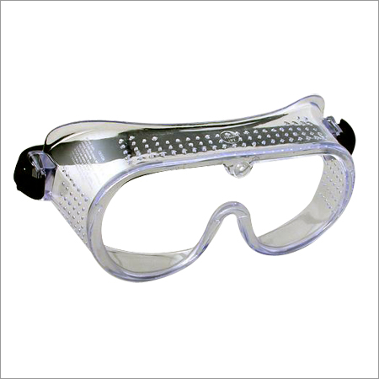
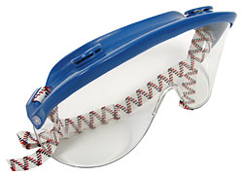
Chemical Splash Goggles NEED to be worn at all times in the Chemistry laboratory. They are impact and splash resistant.
Chemical splash goggles should have indirect ventilation so hazardous substances cannot drain into the eye area. They may be worn over prescription glasses.
Goggles come in a variety of styles for maximum comfort and splash protection. Visorgogs are a hybrid of a goggle and safety glasses. They offer more splash protection than safety glasses, but not as much as goggles. They fit close to the face, but do not seal at the bottom as goggles do.
Verify with your instructor which type of eye protection is allowed in your course.

Slide 8
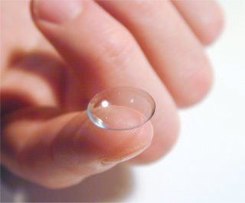
Contact lenses may be worn in the laboratory, but do not offer any protection from chemical contact. If a contact lens becomes contaminated with a hazardous chemical, rinse the eye(s) using an eyewash and remove the lens immediately. Contact lenses that have been contaminated with a chemical must be discarded.
This particularly recommendation runs counter to what most of us were taught previously. However, studies have shown that contact lenses are safe to wear in the laboratory environment. For more information, see the American Optometric Association guidelines.

Slide 9
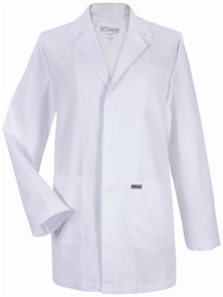
Protective clothing…
When the possibility of chemical contamination exists, protective clothing that resists physical and chemical hazards should be worn over street clothes.
Lab coats are appropriate for minor chemical splashes and solids contamination, while plastic or rubber aprons are best for protection from corrosive or irritating liquids. Disposable outer garments (i.e., Tyvek suits) may be useful when cleaning and decontamination of reusable clothing is difficult.
Loose clothing (such as overlarge lab coats or ties), skimpy clothing (such as shorts), torn clothing and unrestrained hair may pose a hazard in the laboratory.
Instructors will let students know the requirement for lab coats and/or aprons in the particular courses.

Slide 10
Footwear…
Closed-toed shoes NEED to be worn at all times in classrooms where chemicals are stored or used.
Perforated shoes, sandals or cloth sneakers are NOT allowed in laboratories. Such shoes offer no barrier between the laboratory worker and chemicals or broken glass.

Slide 11
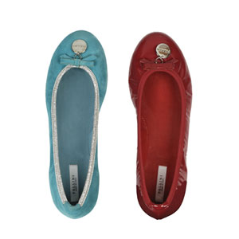
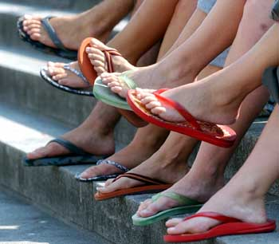
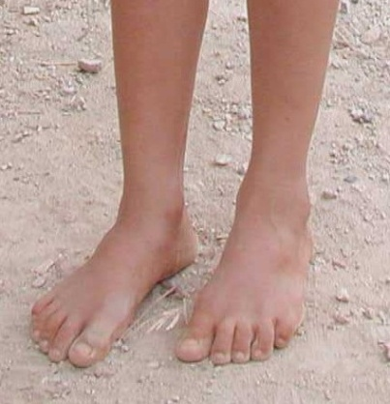

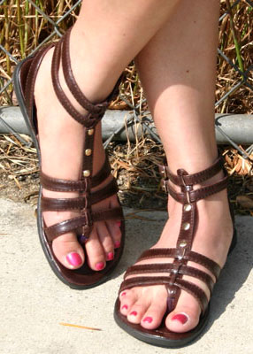
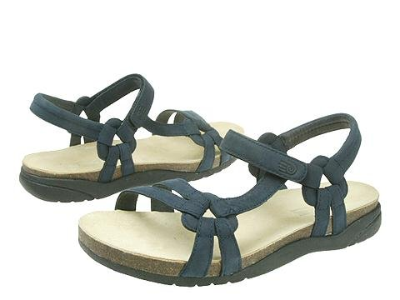
Shoe styles (or lack of) NOT allowed in the lab…
In other words, any shoe style that leaves part of your foot exposed is not allowed in the chemistry laboratory.

Slide 12

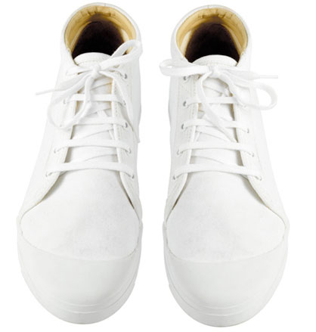
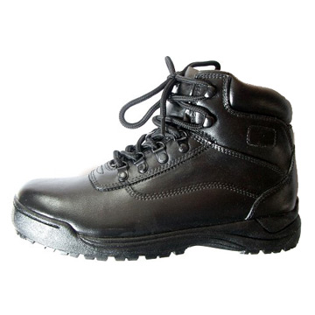
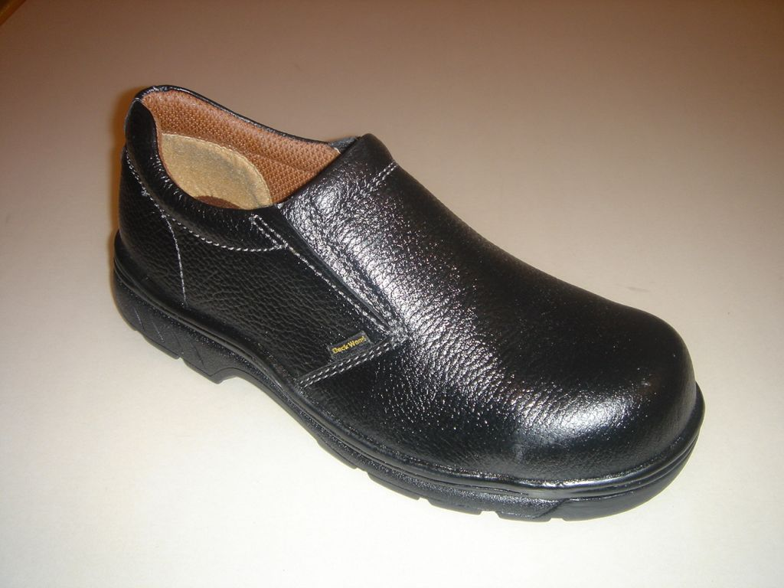
Shoe styles allowed in the lab…
In other words, shoes that cover your entire foot are the appropriate shoes for the chemistry laboratory.

Slide 13

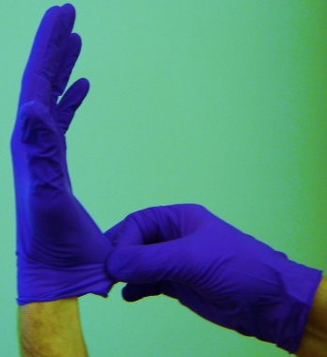
Gloves…
Protective gloves should be worn when handling hazardous materials, chemicals of unknown toxicity, corrosive materials, rough or sharp-edged objects, and very hot or very cold materials.
When handling chemicals in a laboratory, disposable latex, vinyl or nitrile gloves are usually appropriate for most circumstances. These gloves will offer protection from incidental splashes or contact.
Instructors will advise students when gloves need to be worn for particular experiments.

Slide 14
Dress Code…

Slide 15
Students that fail to follow the safety guidelines will be penalized:
1st offense → the student will be given the opportunity to go home, change and return to the lab to finish the class period .
2nd offense → the student will be expelled from the lab and he/she will receive a “zero” for the day’s work.

Slide 16

Goggles are to be worn at all times by students. They are available for sale at the LCCC Bookstore.
Tie back long hair. Long hair can accidentally fall into flames or chemicals. Many hair sprays, gels, mousses, etc. are flammable! Think about this! Loose, long hair can also block your vision, which can lead to accidents.

Slide 17
Wear clothing that fits!
  Do not wear clothing which is loose enough to knock over containers on the work bench or drag or dip into flames or chemicals.
  Wear clothing (shirt, blouse, or dress) which covers and protects your chest, belly, sides, back, shoulders and upper arms.
  No cutouts or cutoffs, tank tops, tube tops, muscle shirts, etc. No peek-a-boo belly buttons either! The skin of your torso must not be exposed at any time in the lab.

Slide 18
  Wear clothing (pants, long skirt or long dress) which covers and protects your body from the waist all the way down to your knees.
  Wear shoes which cover and protect your feet completely. No sandals, flip-flops, open-toed shoes, or shoes with open sides or heels. And no slippers - the top of your foot must be covered!

Slide 19
Dress Recommendations
  Wear comfortable shoes. Hours of walking and standing on a hard tile floor can leave your feet very tired and sore if you wear uncomfortable shoes.
  Wear socks. They offer added padding for your feet, and extra protection to your ankles.
  Wear clothing which "breathes.” The lab can get very warm. Wear cotton or another natural fiber to keep from overheating yourself in the lab.
  Wear clothing which you don't care too much about. Tiny splatters or droplets of chemical are very likely to get on your clothing. You might not even know that the droplets are there. But the chemical can stain your clothes or weaken the fibers of the clothing so that the next time you do the laundry your clothes will come out of the dryer with little, fuzzy holes in them.

Slide 20

  Come prepared to change clothes. If you do not want to spend the entire day dressed in your lab clothes, then put your lab clothes in your book bag. Before lab class begins, you can go to a nearby rest room and change from your regular clothes to your lab clothes. It is also a good idea to have some spare clothes in case of an emergency.
  Do not wear valuable jewelry while working in the lab. Chemicals which are harmless to your body may be capable of damaging jewelry. Take your jewelry off and store it in your purse or book bag before beginning any experiment.

Slide 21
Safety Equipment and how to use it…

Slide 22


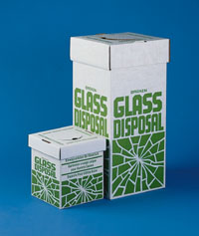
First Aid kit
  First aid kits are located in each laboratory. In case of injury, instructors need to be notified rapidly. Instructors will assess the situation and proceed. In case of a severe injury, the LCCC Campus Security and local EMS services will be notified.
Broom and Dust Pan
  In the lab we use a lot of glassware. Glassware usually winds up getting broken some time during the semester. When that happens, it is unsafe to pick up the broken glass with your hands. Instead, you should use a broom and dust pan to collect the broken glass.
  The broken glass should then be disposed of in the specially marked container provided (White cardboard box with blue or green lettering).

Slide 23
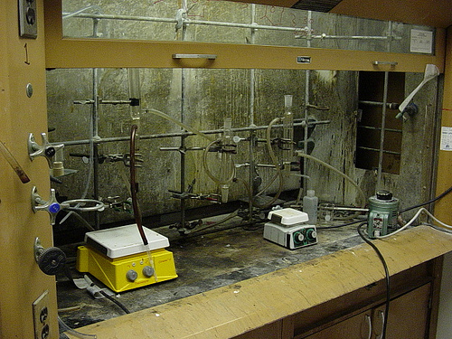
Fume Hoods
  The fume hoods are large cabinets which have sliding glass doors in front. Fume hoods are used to protect you from harmful fumes, gases and odors.
  Your instructor will demonstrate the use of these fume hoods for you.

Slide 24
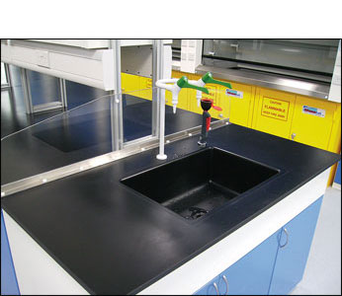
Sinks
- While the sink is used for cleaning glassware and many other tasks, it is also a part of our safety equipment.
- If you happen to get chemicals onto your hands or forearms, you must move quickly to the nearest sink to rinse the chemicals off. The treatment for any chemicals which get on the body is to rinse the affected body area for 15 minutes under cold running water (or as long as you can stand it).
When you are in the lab, if you notice that you have a mysterious itch on your arm which just won't go away, assume that it is a chemical on your skin and wash with soap and plenty of water.
Contact your instructor at all times!

Slide 25
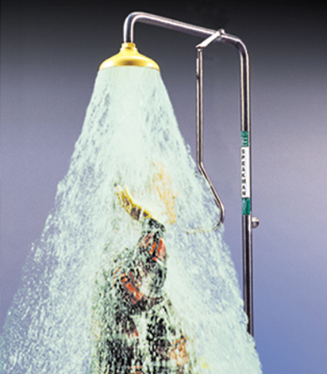

Safety showers and eye wash stations
  Safety showers and eye wash stations are located in each laboratory. When you are in the lab, make sure you locate the safety showers and eye wash stations and look very carefully at them. You should know where they are and how they operate before an accident happens.
  The treatment for any chemicals which get on the body is to rinse the affected body area for 15 minutes under cold running water (or as long as you can stand it).
  If chemicals are splashed into your face they should not reach your eyes because you will be wearing safety goggles. If this sort of accident happens, leave your goggles on while you go to the nearest sink or eye-wash station. There you should wash your face with the goggles still on until you are reasonably sure most of the chemical is gone from your face. Then you should remove your goggles and wash again.
  If chemicals get into your eyes, you should call out for help. If you cannot see, someone will guide you to the nearest sink or eye wash station, where you should wash out your eyes thoroughly. You should blink continuously and rapidly while washing your eyes to aid the flushing action of the water.
  If chemicals get onto your body, you should quickly remove any contaminated clothing and rinse yourself off in a safety shower.
  Make sure to contact your instructor at all times.

Slide 26
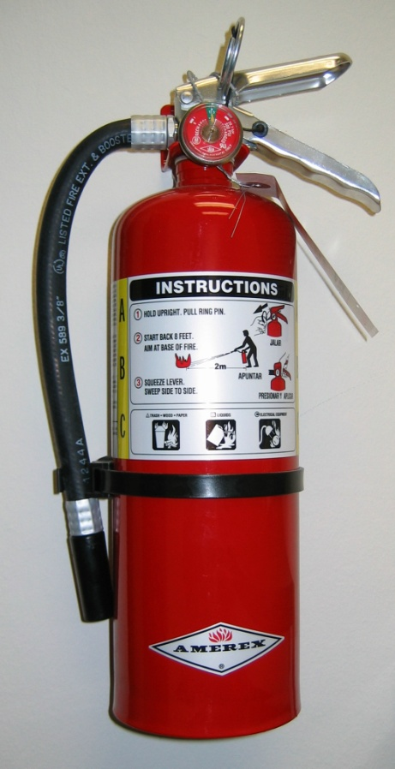
Fire extinguishers
  There are fire extinguishers in each laboratory. While you are in the laboratory, please look carefully at the fire extinguishers.
  Notice how they are attached to the wall, and what you would have to do to get them off of the wall. Read the instructions on the side of the fire extinguisher so you will be familiar with their use.
  If you ever need to use a fire extinguisher, remember the following (A) pull the pin, (B) aim to the side at first, (C) depress the handle, (D) sweep the spray from side to side across the BASE of the fire (where the fire meets the fuel), not just at the flames! When the fire is out, clean up the area!
  Note: Never spray a person with a fire extinguisher. The chemicals in the fire extinguisher can be harmful.

Slide 27

Alarms
Each classroom and laboratory has a guide to Campus Emergencies posted.
- Locate the guide in your laboratory and become familiar with the procedures for each type of emergency.
- You can also go to the campus police website for more information:
http://www.lorainccc.edu/Campus+Security/

Slide 28
Telephone
  There is a limited access, emergencies-only telephone in the laboratory.
  If someone asks you to call for help, call the Campus Security (X4444) or 911.
  Then, give all the necessary information (building, room number, what happened, etc.).
  If a cell phone is being used, you need to call Campus Security at 440-366-4444.

Slide 29


What to Do in Case of an Accident:
Always tell your instructor about all accidents immediately!!!
Broken glass: Do not pick up broken glass with your fingers! Get a broom and dust pan. Sweep the broken glass into the dust pan and dump it into the specially marked containers provided in each lab.
Small chemical spill: Wipe up liquid spills with paper towels and dispose of them as your instructor suggests. Solids should be dissolved in water, if possible, and wiped up. Otherwise, sweep them up with a broom and a dust pan and dispose of them as your instructor suggests. In all cases, after the chemical spill has been wiped up, rinse the area with water to make sure that all residual chemicals have been removed.
Large chemical spill: Move away from the area of the spill. Warn the people around you LOUDLY. Call your instructor! Let the expert handle the clean-up!

Slide 30

Chemical splash in your face, goggles on: If the goggles have protected your eyes, DON’T TAKE YOUR GOGGLES OFF! Yell for help. Go to the nearest sink or eye wash station and rinse your face quickly with the goggles still on. Then remove the goggles and rinse your face again.
Chemical splash or broken glass in your face, goggles off: If this sort of accident happens, you may not be able to see well enough to go to the nearest sink or eye wash station on your own. YELL LOUDLY FOR HELP and cooperate with anyone who comes to your aid.
Large splash of dangerous chemical on your clothing and/or body: Quickly follow this procedure while continuously YELLING FOR HELP:
  A. Move away from the area where the spill occurred (you don't want to get more chemical on you).
  B. CALL LOUDLY FOR HELP and to warn others to stay away from the spill!
  C. Remove any contaminated clothing.
  D. Use the safety shower. (The treatment for chemical exposure is 15 minutes under cold running water, or as long as you can stand it.)

Slide 31

Small, confined fire: If you have a small fire in a container, (for instance, a small beaker full of alcohol has caught fire) find something you can use as a lid for the container. When the container is covered, the fire will quickly burn itself out. Call the instructor for help.
Small, open fire : If you have a small fire which is not in a container, move away from the fire and SHOUT FOR HELP! You can use a fire extinguisher to put the fire out.
If you ever need to use a fire extinguisher, remember the following (A) pull the pin, (B) aim to the side at first, (C) depress the handle, (D) sweep the spray from side to side across the BASE of the fire (where the fire meets the fuel), not just at the flames! When the fire is out, clean up the area!
Large fire: SHOUT FOR HELP and leave the area immediately! The fire alarm will probably sound. When it does, evacuate the building and TELL EVERYONE YOU CAN, where the fire is.

Slide 32
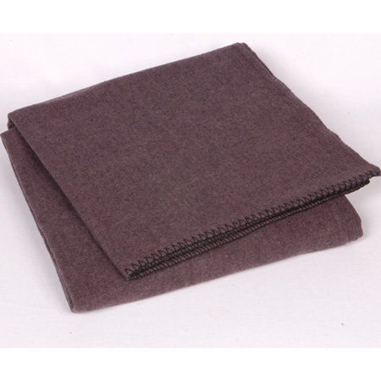
Your clothing on fire: Don't run! It will only fan the flames and make the fire worse! Instead, you should STOP moving, DROP to the ground (lie down!), and ROLL on the ground to squash out the flames! YELL continuously! We also have fire blankets in the laboratory for this purpose.
Fire blankets can also be used to put out fires on equipment. Just drop the blanket on top of the fire.
Note: If you want to help a person who is in this sort of trouble, don't use a fire extinguisher! You must never use a fire extinguisher on a human being. The chemicals in the extinguisher can be harmful!
Fire Alarm: If a fire alarm sounds you must evacuate the building immediately! (follow Campus emergency procedures)

Slide 33
To evacuate the lab properly, you should quickly and calmly do the following:
Turn off all flames and unplug any hot plates or other electric equipment you are using.
Follow the instructions provided by your instructor.
Get your stuff if time allows: Take your book bag, purse, car keys, etc. with you. We never know whether the evacuation will last for 5 minutes or 5 hours. You don't want to become stranded on campus!
Walk calmly out the door, down the hall, down the stairs (elevators should not be used during an emergency unless you are handicapped), out the door and away from the building.
In case of a weather emergency, all students and instructors should proceed to the basement of the building.
For information about other types of emergencies please see the Campus Security website at http://www.lorainccc.edu/Campus+Security/

Slide 34
What to Do in Case of an Injury or Illness:
Small cut: Tell your instructor, and let your instructor look at the injury. Wash the injury thoroughly with water. If the injury is minor, you may use the first aid kit in the laboratory. If your injury still hurts so badly that you can't finish the experiment, then you may be escorted to a health care provider so the cut can be treated. The Campus Security will be called and, if transportation cannot be arranged, an EMS unit will be called.
Large cut: Tell your instructor, and let your instructor look at the injury. To stop or slow down bleeding, apply pressure to the wound. If the wound is very large or there is glass or other foreign matter in the wound, then apply pressure around the arm or leg (between the body's torso and the injury) to slow the bleeding. In all cases, a large cut must be attended to by medical professionals! The Campus Security will be called and, if transportation cannot be arranged, an EMS unit will be called.

Slide 35
Small burn: Tell your instructor, and let your instructor look at the injury. Chemical burns and heat burns should both be treated with lots of cold running water. Never put anything but cold water on a burn! Doctors often have to remove ointments because they retard healing! After this treatment, if the burn still hurts badly enough that you cannot complete the experiment, the Campus Security will be called and, if transportation cannot be arranged, an EMS unit will be called.
Large burn: In all cases, a large burn must be attended to by medical professionals! Tell your instructor, and let your instructor look at the injury. The Campus Security will be called and, if transportation cannot be arranged, an EMS unit will be called.

Slide 36
Fainting: In all cases, Campus Security and an EMS team will be called! If you feel like you might faint, please notify your instructor or lab partner before it is too late. You can usually lie down there, and you may avoid the expense of calling for emergency help.
Breathing difficulties: In all cases, the Campus Security will be called and, if transportation cannot be arranged to a medical care facility, an EMS unit will be called.

Slide 37
Symbols in the lab…

Slide 38





Eyewash Station
Defibrillator
Shower
Fire Blanket
First Aid
Fire extinguisher

Slide 39




Radiation
Biohazard

Slide 40






Explosive or Explosive Hazard
Toxic Substances
Harmful or irritant
Oxidizer
Flammable
Corrosive

Slide 41
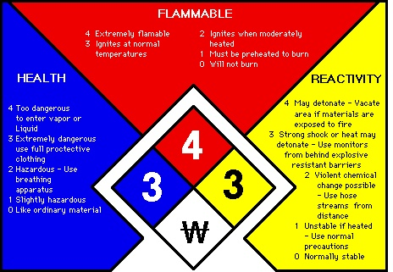

Slide 42

MSDS: document with data regarding the properties of a particular substance.
It is intended to provide workers and emergency personnel with procedures for handling or working with that substance in a safe manner, and includes information such as physical data (melting point, boiling point, flash point, etc.), toxicity, health effects, first aid, reactivity, storage, disposal, protective equipment, and spill-handling procedures.
MSDS are available in the Stock Room and on-line.

