Slide 1
Study Skills
Strategies for academic Success

Slide 2
Studying 101: Study Smarter not Harder
Notes:
Do you ever feel like your study habits simply aren’t cutting it? Do you wonder what you could be doing to perform better in class and on exams?
Many students ask questions like these.
We will spend some time today re-framing the concept of studying.
You *might never have a midnight cram session again. (That’s the hope, anyway.)

Slide 3
The Do’s and Don’ts
First: what doesn’t work?
Notes:
It’s just as important to know what *not to do, as it is to know what TO do. So, first, let’s take a look at some habits to avoid: here are six mistakes you might be making during your study sessions.

Slide 4
6 Mistakes You Might Be Making …
#1. Studying for too long.
No marathon study sessions!
Try this instead: 25 minutes on, 5 minutes off
1. The College Juice, 10/06/2017
2. Emily Morantz, students.ubc.ca
Notes:
#1. Studying for too long. It’s true! You really shouldn’t study for too long at one time! Keep study sessions shorter and make sure to take breaks.

Slide 5
6 Mistakes You Might Be Making …
#2. Only re-reading your notes.
Try these more effective tactics:
Quiz yourself
Create outlines
Summarize
https://www.inc.com/wanda-thibodeaux/heres-how-much-time-
people-actually-spend-reading-each-day.html
The College Juice, 10/06/2017
Notes:
#2. Only re-reading your notes. Simply reading and re-reading texts or notes is not actively engaging in the material. Your learning will require a more comprehensive approach. Try these more effective tactics:

Slide 6
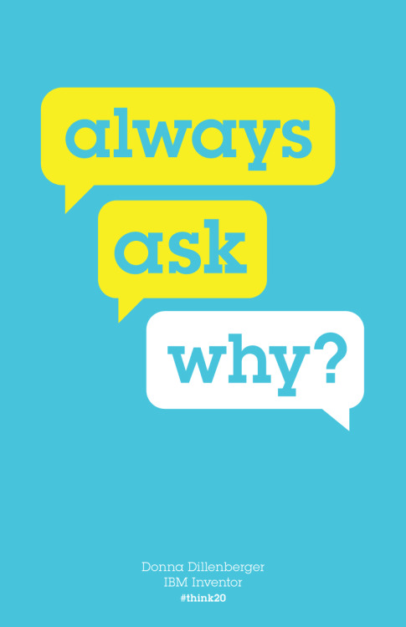
6 Mistakes You Might Be Making …
#3. Memorizing
… instead of understanding.
Make sure you actually understand
what you’re learning …
The College Juice, 10/06/2017
Notes:
#3. (This one is huge!) Don’t just memorize answers. When you strive for understanding, you’ll not only be more confident and knowledgeable, but you will retain the information for much longer.

Slide 7
6 Mistakes You Might Be Making …
#4. Cramming.
Procrastination (more on this later) compounds stress!
Try this instead:
Break up the material into multiple study sessions leading up to exam day.
The College Juice, 10/06/2017
Notes:
#4. Cramming. Who *hasn’t done this?? Last minute information will be fresh in your mind, right? Actually, no; and you’ll be more stressed! Try this instead: Break up the material into multiple study sessions leading up to exam day.

Slide 8
6 Mistakes You Might Be Making …
#5. Pulling all-nighters.
Just … don’t.
Your brain needs sleep!
https://archive.shine.cn/metro/education/Cramming-takes-fun-out-of-school-holidays/shdaily.shtml
The College Juice, 10/06/2017
Notes:
#5. Pulling all-nighters. This one is even worse than cramming. Your brain needs sleep in order to process and retain information. Preparation keeps your stress level down, too.

Slide 9
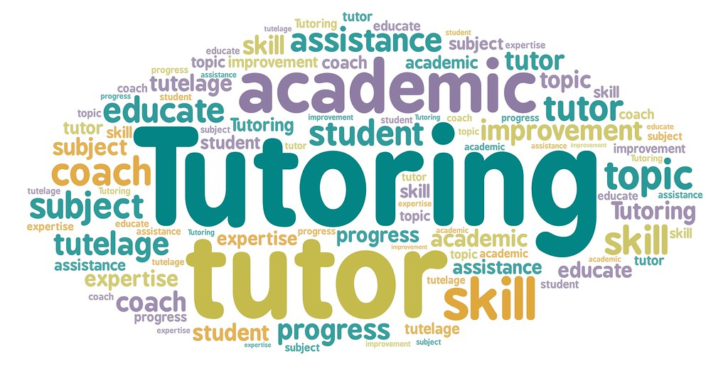
6 Mistakes You Might Be Making …
#6. Not seeking help.
Use
your
resources!
https://www.facebook.com/pages/category/Tutor-Teacher/BYU-Covid-Tutors-Free-Tutoring-Services-107211087648615/
The College Juice, 10/06/2017
Notes:
And #6. Not seeking help. Take control of your academic life. You can be more in control when you seek out and use all of the available resources to help yourself. This will help you to achieve your goals.

Slide 10
Goals & Time Management
Notes:
What was that last bit about goals?
Yes, that’s right, having goals is so important! Set both short-term and long-term goals.
Want an A? Want to write a great essay? Specify what you want and keep that goal visible until you reach it.
You’ll need to wisely manage your time to achieve your goals.

Slide 11
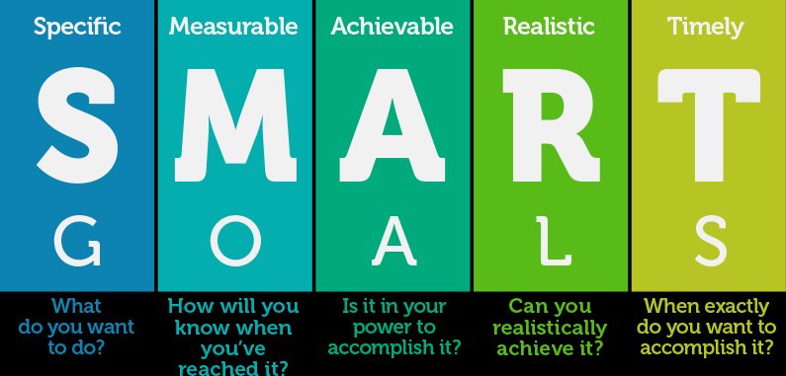
https://redcapsalescoaching.com/smart-goals-2018/
Notes:
Each goal should be SMART: specific, measurable, achievable, realistic, and timely.
S – What, specifically, do you want to accomplish?
M – How will you know when you’ve reached your goal? You’ll want some tangible evidence of completion.
A – Achievable, or attainable. Is it in your power to accomplish it? Your goal should be challenging, but *realistic.
R – Can you realistically achieve it? This R is sometimes referred to as “Relevant” since a goal that is aligned with your values and life goals will be applicable to your self-improvement.
T – When exactly do you want to accomplish it? Don’t leave the time frame open-ended for “some day.”
Manage your commitments along the way and celebrate small victories.

Slide 12
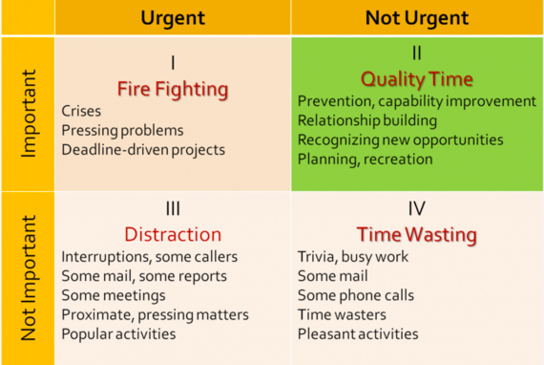
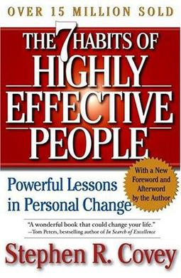
Stephen Covey’s Time Management
https://youtu.be/ODyG5lKbH08
https://upload.wikimedia.org/wikipedia/en/a/a2/
The_7_Habits_of_Highly_Effective_People.jpg
https://www.huffpost.com/entry/what-stephen-covey-taught_b_12458334
Notes:
Stephen Covey is the author of The 7 Habits of Highly Effective People.
This short video discusses Covey’s time-management matrix. It is addressed to those in business, but can apply to anyone.
It could get you thinking about your own priorities.
< play video >
As you saw, it is crucial to your productivity for you to be able to determine the activities that fall within each quadrant.
Overall, Covey believes that we need to spend more time in Quadrant 2 - the quadrant that is often neglected but extremely important in reaching one’s goals.

Slide 13
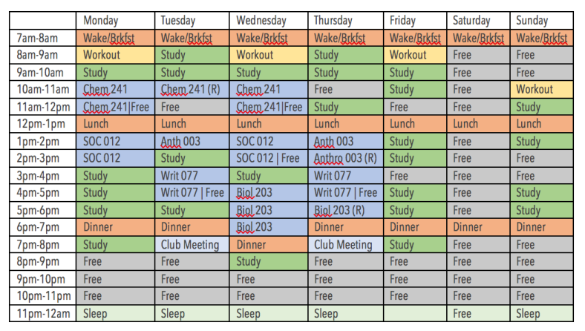
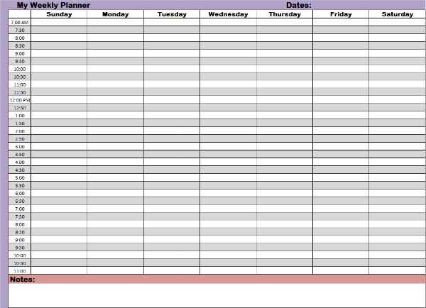
Sample Schedule from https://weingartenlrc.wordpress.com/2017/03/21/scheduling-to-reduce-stress/
Image: https://www.time-management-abilities.com/weekly-planners.html
Planning info: https://myclasstracker.com/blogs/news/how-to-create-a-weekly-plan-that-will-make-you-successful-in-college
Notes:
Using a weekly time grid like this one will help you get organized and plan for success.
Here’s how it works:
Part 1: Map out your week so you can see your unscheduled/free time.
Step 1: Block out your classes and work study/job.
Step 2: Block out when you will wake up, get ready for the day, eat and plan to go to sleep.
Step 3: Block out when you want to exercise (or something to take care of you!).
Part 2: Block out time that you will work on school assignments.
Your finished grid will look something like this sample schedule.
Part 3: Know what you need to get done this week and the next (two or three).

Slide 14
What is Studying?
Notes:
What is studying?
Take a moment and think about your own answer to this question.
Many students are unsure of HOW to study … but the answer to “How do I study?” really comes from understanding *what studying is … let’s take a look.

Slide 15
Studying is …
Planned learning.
Preparation.
Actively engaging with the material.
A process.
Notes:
That process begins before class even meets. Classes vary, but preparation is the key to success for all. Let’s look at the Study Cycle.

Slide 16
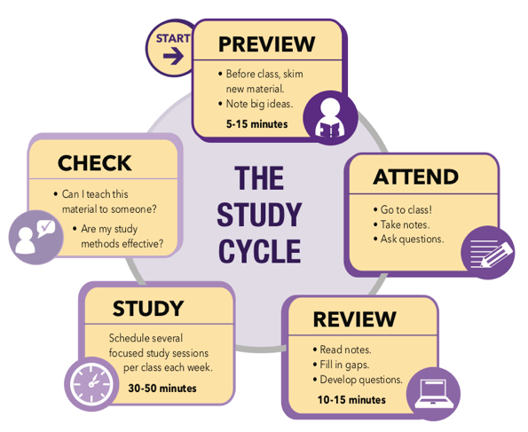
Adapted from Frank Christ’s PLRS system
(Copyright Louisiana State University, 2015,
Center for Academic Success).
https://youtu.be/6vEWBnIqxcg

Slide 17
Reading is not studying …
Active Studying
Ideas
Making connections
Forming examples
Asking questions
Evaluating evidence
Create a study guide
Teach someone
Use concept mapping
Quiz yourself
Leave no “islands” of information
The University of North Carolina Learning Center
https://learningcenter.unc.edu/tips-and-tools/studying-101-study-smarter-not-harder/

Slide 18
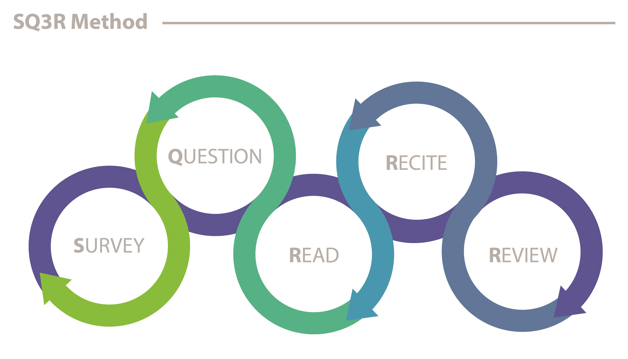
Reading is not studying … unless it’s SQ3R
Graphic and explanation: https://usm.maine.edu/agile/sq3r-method
Notes:
Survey: This means previewing the titles, headings, sections, diagrams, and other content.
Question: During the surveying process, ask yourself some questions … It can be helpful to ask questions related to a section heading.
Read: Begin to read, with the goal of a few paragraphs or one section at a time. Search for the answers to your questions as you go along.
Recite: After reading a few paragraphs or one section as described above, stop reading and take time to recite – you’ll summarize the section in your own words. If you’re able to recall and explain the key information, great! Move to the next section. If not, go back and try again before moving forward.
Review: Once you’ve arrived at the end of the chapter or article, take just a few moments to review. Use your own words to summarize the most important aspects of the reading, and remind yourself why it is important.

Slide 19
Taking Notes
Outline
Cornell Method
Concept Maps
Examples
Handwritten?
Digital?
… Or both?
Notes:
There are numerous ways of taking good notes. Try something and find what works for you and the material you need to learn. Examples are best used for math classes.
But you’ll still need to decide … do you want to hand-write your notes? Type them? Or use some combination of the two?

Slide 20
Cornell Note-taking Method
https://www.pngkey.com/detail/u2e6e6a9q8r5e6u2_cornell-note-taking-method-ued102-taking-lecture-note/

Slide 21
Concept Mapping
Flowcharts
Comparisons
Relationships
https://www.lucidchart.com/pages/templates/concept-map/bubble-concept-map-template

Slide 22
Not all studying is equal …
It’s good to be intense!
Short, intensive sessions
Distributed; focused
Prevents procrastination
The University of North Carolina Learning Center
https://learningcenter.unc.edu/tips-and-tools/studying-101-study-smarter-not-harder/

Slide 23
Procrastination

Slide 24
https://www.purdue.edu/asc/resources/pdfs/ASC_Handouts_OvercomingProcrastination.pdf

Slide 25
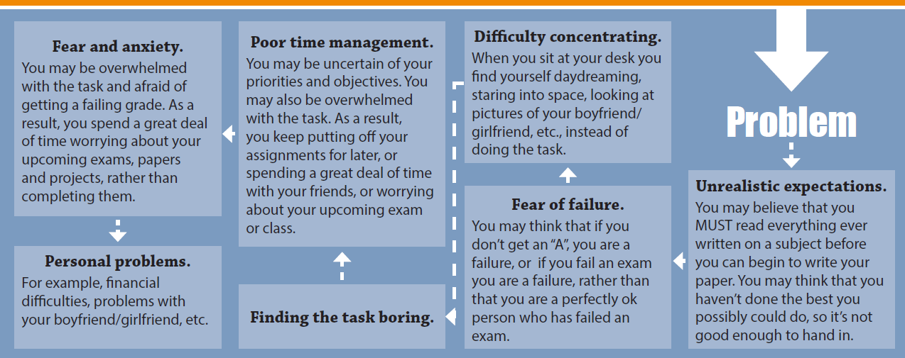
https://www.purdue.edu/asc/resources/pdfs/ASC_Handouts_OvercomingProcrastination.pdf

Slide 26
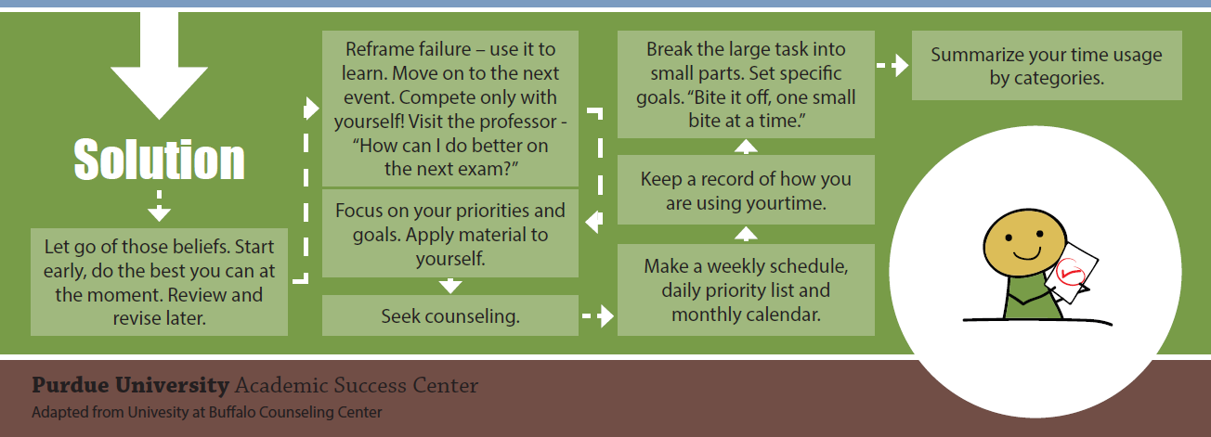
https://www.purdue.edu/asc/resources/pdfs/ASC_Handouts_OvercomingProcrastination.pdf

Slide 27
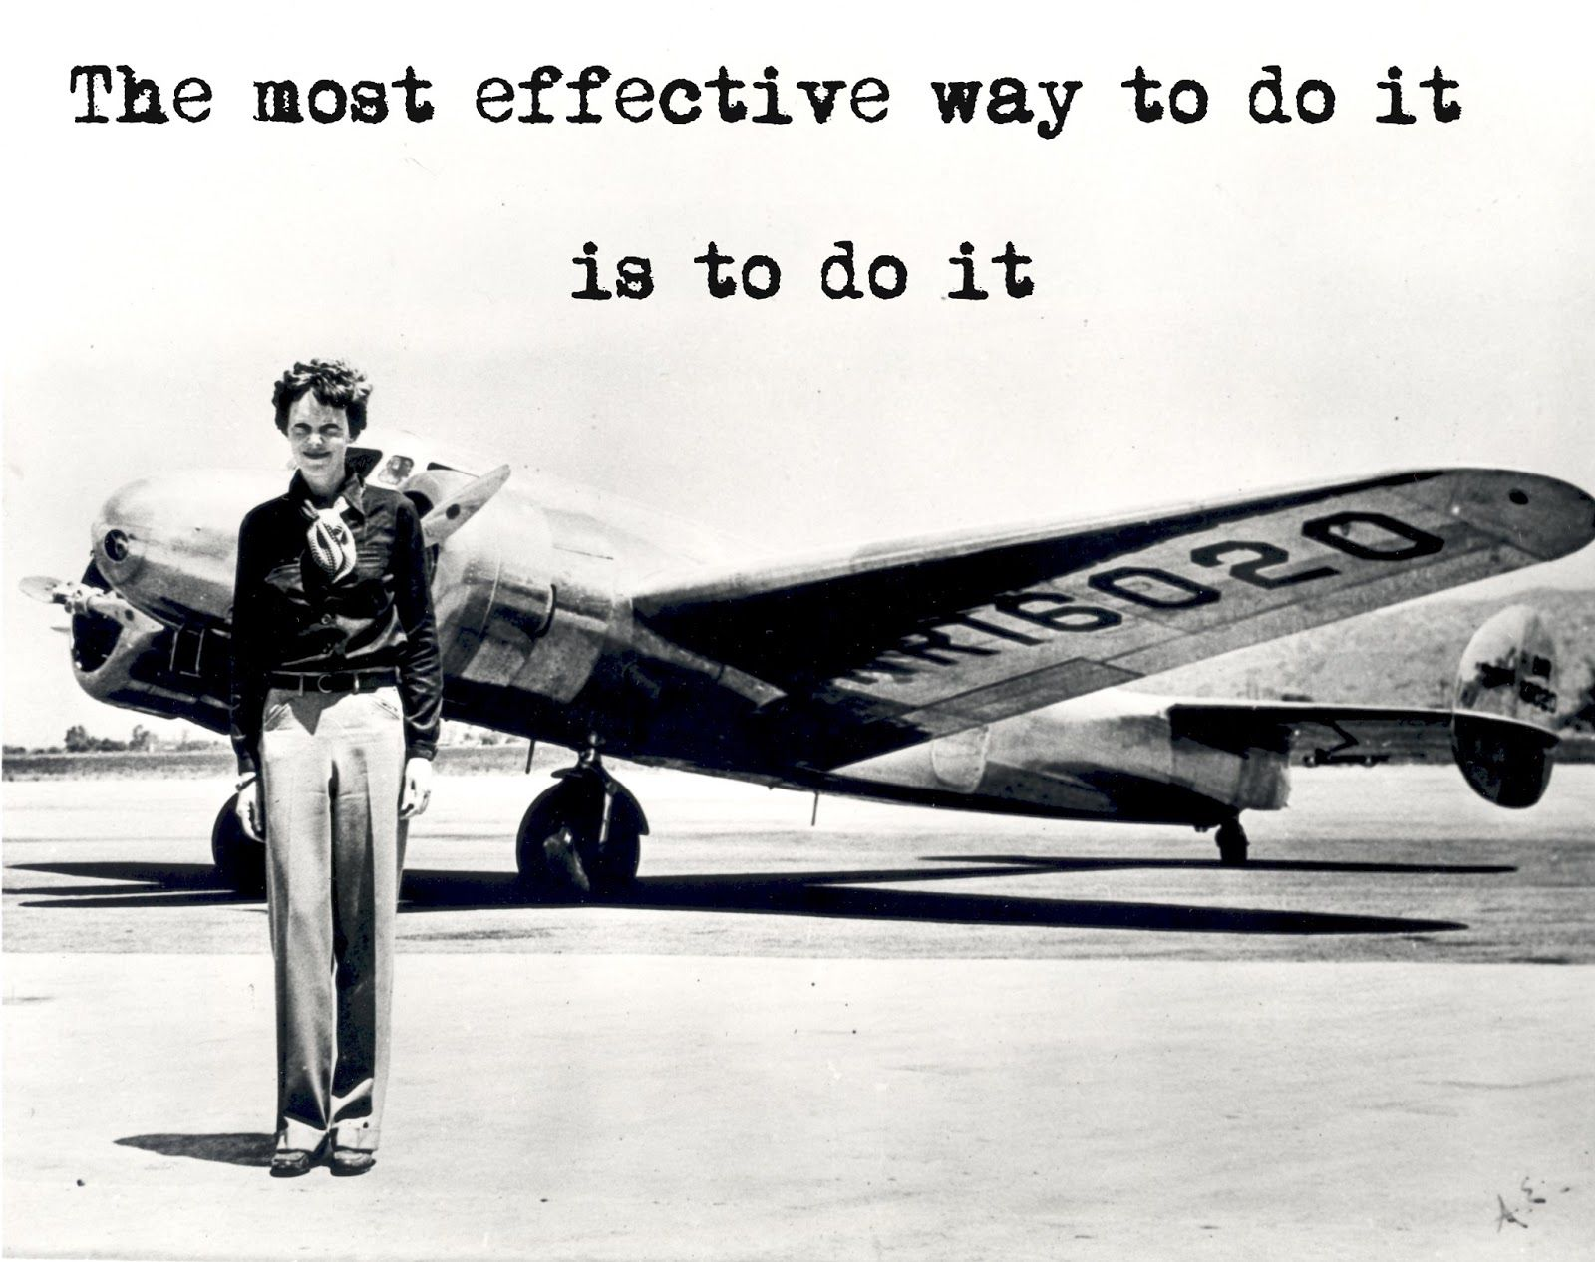
https://www.pinterest.com/pin/510173464023931680/
Notes:
The most effective way to do it, is to do it. ~ Amelia Earhart

Slide 28
Study Skills
Crash course series
Louisiana State University
Unc – Chapel Hill
Purdue university
MCC SUCCESS CENTER
https://youtu.be/IhuwS5ZLwKY
lsu.edu/cas/
learningcenter.unc.edu/tips-and-tools/
purdue.edu/asc/resources/allHandouts.html
Loper Hall, Room 110; M-Th. 9:00-2:00
Email: mccsuccesscenter@eicc.edu
Notes:
The online resources to help with your academic success are extensive. Here’s a list of a few that I liked and used in this presentation. When you’re on campus, stop by the Success Center or send us an email; we will coordinate time with a tutor.

Slide 29
Studying is …
Planned learning.
Preparation.
Actively engaging with the material.
A process.
dreamstime.com (image109775114)

Slide 30
Study Skills
Strategies for academic Success
Alice Pittman, MCC Success Center

